Slide 1
CS 7643: Deep Learning
Topics:
Stride, padding
Pooling layers
Fully-connected layers as convolutions
Backprop in conv layers
Dhruv Batra
Georgia Tech

Slide 2


Invited Talks
Sumit Chopra on CNNs for Pixel Labeling
Head of AI Research @ Imagen Technologies
Previously Facebook AI Research
Tue 09/26, in class

Slide 3
Administrativia
HW1 due soon
09/22
HW2 + PS2 both coming out on 09/22
Note on class schedule coming up
Switching to paper reading starting next week.
https://docs.google.com/spreadsheets/d/1uN31YcWAG6nhjvYPUVKMy3vHwW-h9MZCe8yKCqw0RsU/edit#gid=0
First review due: Tue 09/26
First student presentation due: Thr 09/28

Slide 4

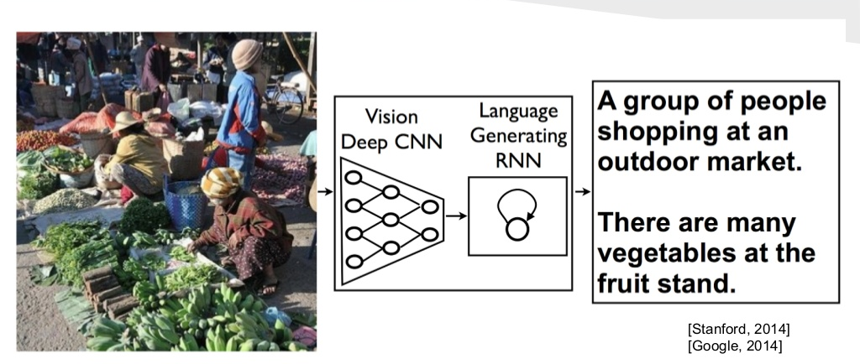
Paper Reading Intuition: Multi-Task Learning
Paper 1
Task Layers
Paper 2
Task Layers
data
Shared Layer 1
Shared Layer 2
…
…
Shared Layer N
...
Lectures
Paper of the Day
Task Layers
Paper 6

Slide 5
Paper Reviews
Length
200-400 words.
Due: Midnight before class on Piazza
Organization
Summary:
What is this paper about? What is the main contribution? Describe the main approach & results. Just facts, no opinions yet.
List of positive points / Strengths:
Is there a new theoretical insight? Or a significant empirical advance? Did they solve a standing open problem? Or is a good formulation for a new problem? Or a faster/better solution for an existing problem? Any good practical outcome (code, algorithm, etc)? Are the experiments well executed? Useful for the community in general?
List of negative points / Weaknesses:
What would you do differently? Any missing baselines? missing datasets? any odd design choices in the algorithm not explained well? quality of writing? Is there sufficient novelty in what they propose? Has it already been done? Minor variation of previous work? Why should anyone care? Is the problem interesting and significant?
Reflections
How does this relate to other papers we have read? What are the next research directions in this line of work?

Slide 6
Presentations
Frequency
Once in the semester: 5 min presentation.
Expectations
Present details of 1 paper
Describe formulation, experiment, approaches, datasets
Encouraged to present a broad picture
Show results, videos, gifs, etc.
Please clearly cite the source of each slide that is not your own.
Meet with TA 1 week before class to dry run presentation
Worth 40% of presentation grade

Slide 7
Administrativia
Project Teams Google Doc
https://docs.google.com/spreadsheets/d/1AaXY0JE4lAbHvoDaWlc9zsmfKMyuGS39JAn9dpeXhhQ/edit#gid=0
Project Title
1-3 sentence project summary TL;DR
Team member names + GT IDs

Slide 8
Recap of last time

Slide 9
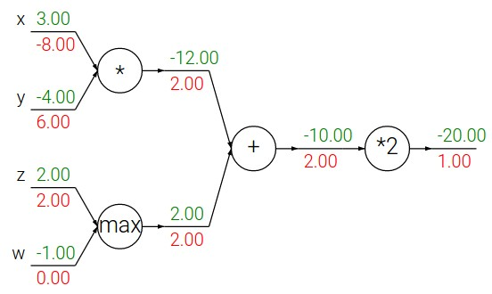
Patterns in backward flow
Slide Credit: Fei-Fei Li, Justin Johnson, Serena Yeung, CS 231n

Slide 10
Patterns in backward flow
add gate: gradient distributor
Slide Credit: Fei-Fei Li, Justin Johnson, Serena Yeung, CS 231n

Slide 11
Patterns in backward flow
add gate: gradient distributor
Q: What is a max gate?
Slide Credit: Fei-Fei Li, Justin Johnson, Serena Yeung, CS 231n

Slide 12
Patterns in backward flow
add gate: gradient distributor
max gate: gradient router
Q: What is a mul gate?
Slide Credit: Fei-Fei Li, Justin Johnson, Serena Yeung, CS 231n

Slide 13
Patterns in backward flow
add gate: gradient distributor
max gate: gradient router
mul gate: gradient switcher
Slide Credit: Fei-Fei Li, Justin Johnson, Serena Yeung, CS 231n
Notes:
Gradient switcher and scaler
Mul: scale upstream gradient by value of other branch

Slide 14
Duality in Fprop and Bprop
FPROP
BPROP
SUM
+
COPY
+

Slide 15
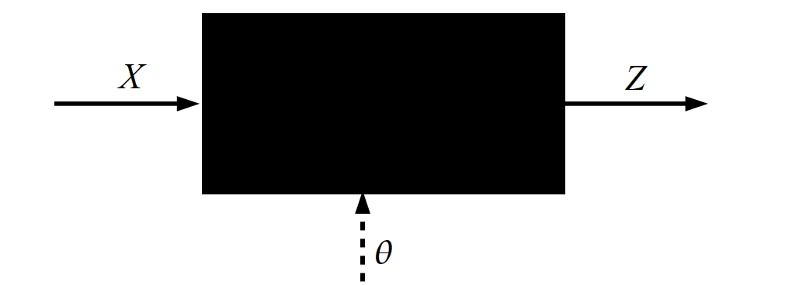
Key Computation in DL: Forward-Prop
Slide Credit: Marc'Aurelio Ranzato, Yann LeCun

Slide 17
Jacobian of ReLU
f(x) = max(0,x)
(elementwise)
4096-d
input vector
4096-d
output vector
Q: what is the size of the Jacobian matrix?
Slide Credit: Fei-Fei Li, Justin Johnson, Serena Yeung, CS 231n
Notes:
Partial deriv. Of each dimension of output with respect to each dimension of input

Slide 18
Jacobians of FC-Layer

Slide 19
Jacobians of FC-Layer

Slide 20
Convolutional Neural Networks
(without the brain stuff)
Slide Credit: Fei-Fei Li, Justin Johnson, Serena Yeung, CS 231n

Slide 21
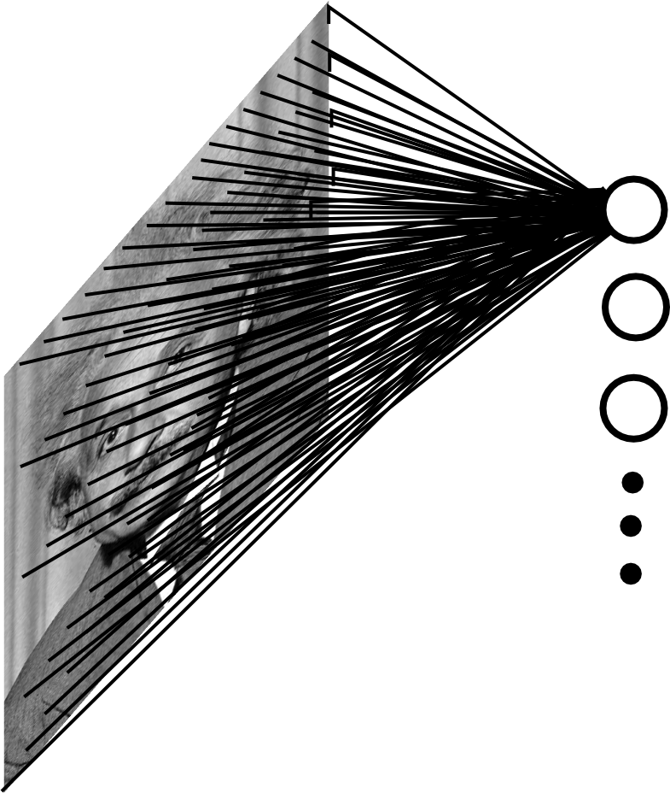
Fully Connected Layer
Example: 200x200 image
40K hidden units
~2B parameters!!!
- Spatial correlation is local
- Waste of resources + we have not enough training samples anyway..
Slide Credit: Marc'Aurelio Ranzato

Slide 22
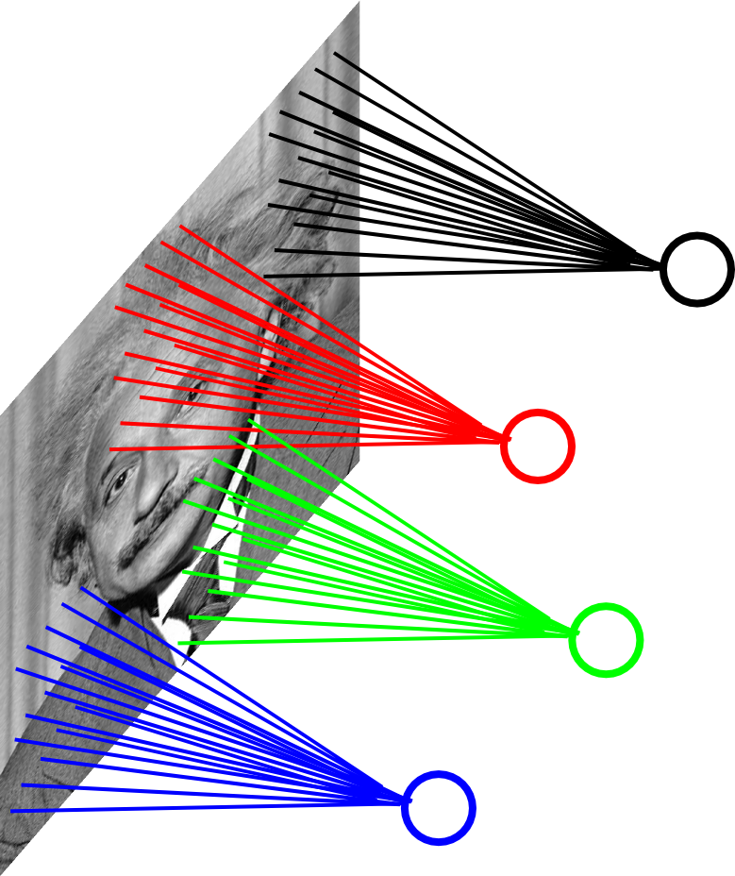
Locally Connected Layer
Example: 200x200 image
40K hidden units
Filter size: 10x10
4M parameters
Note: This parameterization is good when input image is registered (e.g., face recognition).
Slide Credit: Marc'Aurelio Ranzato

Slide 23
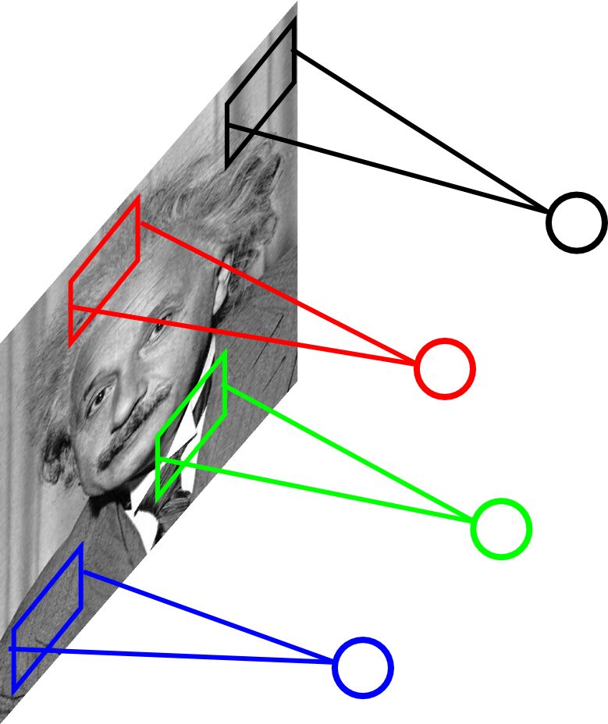
Locally Connected Layer
STATIONARITY? Statistics is similar at different locations
Example: 200x200 image
40K hidden units
Filter size: 10x10
4M parameters
Note: This parameterization is good when input image is registered (e.g., face recognition).
Slide Credit: Marc'Aurelio Ranzato

Slide 24
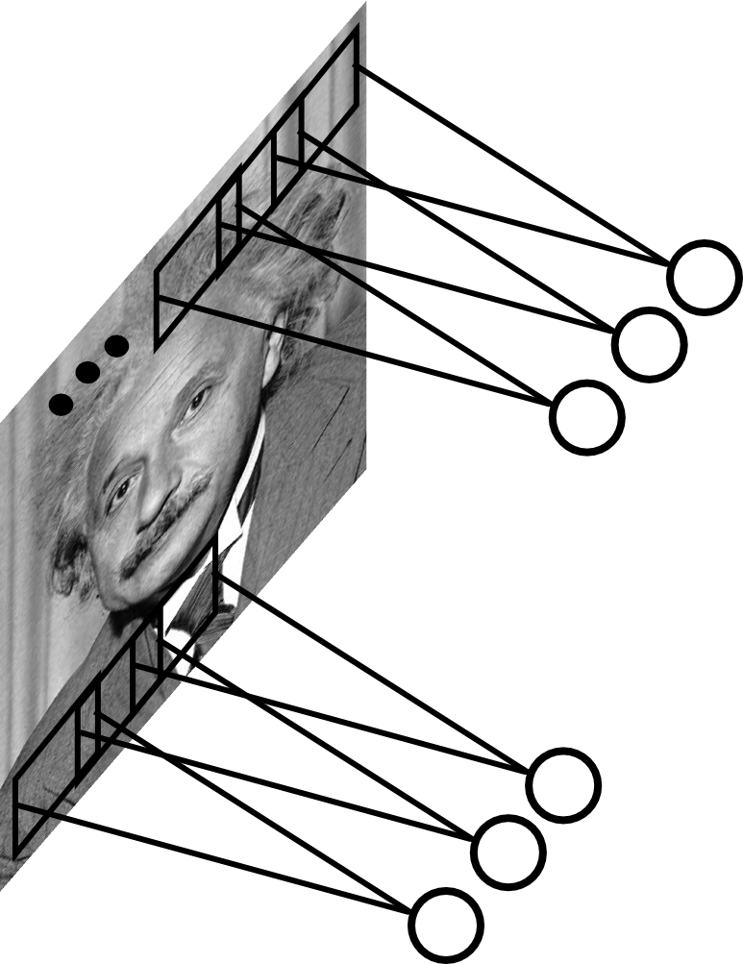
Convolutional Layer
Share the same parameters across different locations (assuming input is stationary):
Convolutions with learned kernels
Slide Credit: Marc'Aurelio Ranzato

Slide 25
Convolutions for mathematicians

Slide 26


"Convolution of box signal with itself2" by Convolution_of_box_signal_with_itself.gif: Brian Ambergderivative work: Tinos (talk) - Convolution_of_box_signal_with_itself.gif. Licensed under CC BY-SA 3.0 via Commons - https://commons.wikimedia.org/wiki/File:Convolution_of_box_signal_with_itself2.gif#/media/File:Convolution_of_box_signal_with_itself2.gif

Slide 27
Convolutions for computer scientists

Slide 28
Convolutions for programmers

Slide 29
Convolution Explained
http://setosa.io/ev/image-kernels/
https://github.com/bruckner/deepViz

Slide 30
Plan for Today
Convolutional Neural Networks
Stride, padding
Pooling layers
Fully-connected layers as convolutions
Backprop in conv layers

Slide 31
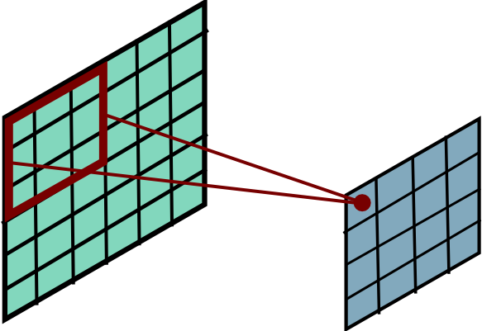
Convolutional Layer
Slide Credit: Marc'Aurelio Ranzato

Slide 32
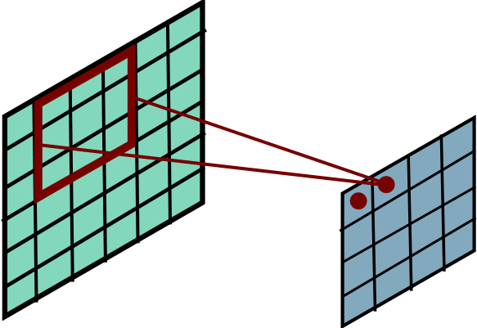
Convolutional Layer
Slide Credit: Marc'Aurelio Ranzato

Slide 33
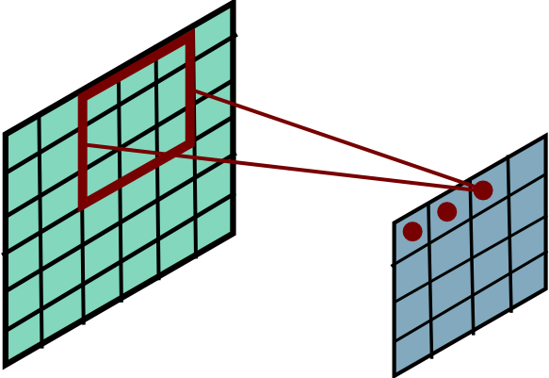
Convolutional Layer
Slide Credit: Marc'Aurelio Ranzato

Slide 34
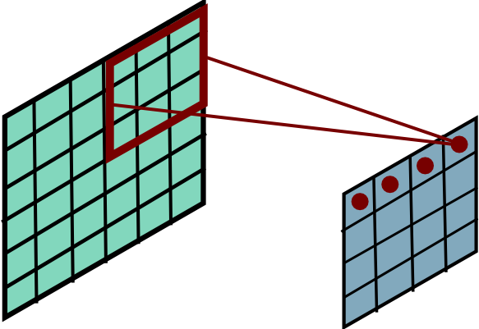
Convolutional Layer
Slide Credit: Marc'Aurelio Ranzato

Slide 35
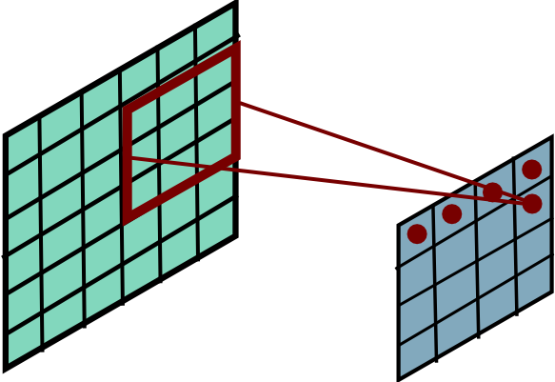
Convolutional Layer
Slide Credit: Marc'Aurelio Ranzato

Slide 36
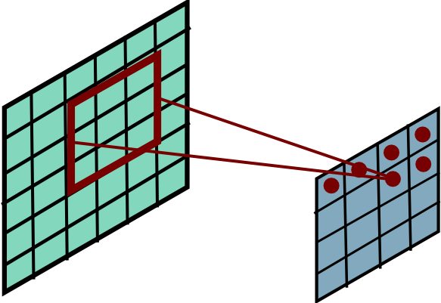
Convolutional Layer
Slide Credit: Marc'Aurelio Ranzato

Slide 37
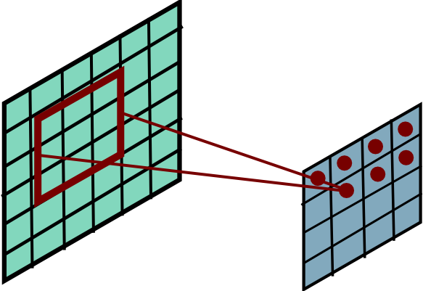
Convolutional Layer
Slide Credit: Marc'Aurelio Ranzato

Slide 38
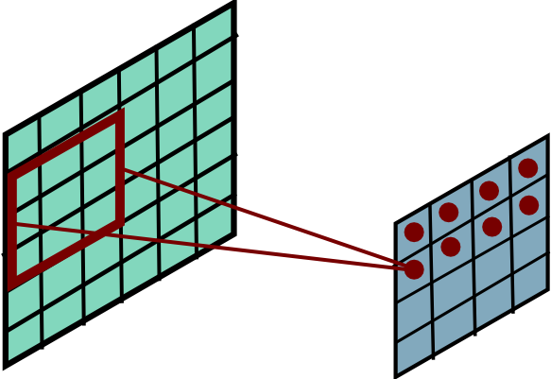
Convolutional Layer
Slide Credit: Marc'Aurelio Ranzato

Slide 39
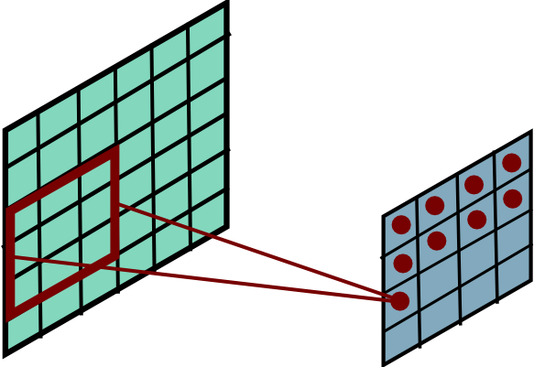
Convolutional Layer
Slide Credit: Marc'Aurelio Ranzato

Slide 40
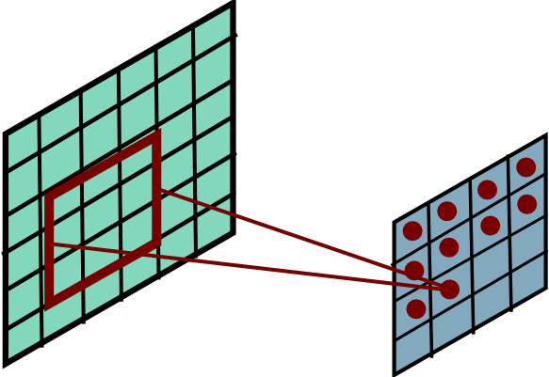
Convolutional Layer
Slide Credit: Marc'Aurelio Ranzato

Slide 41
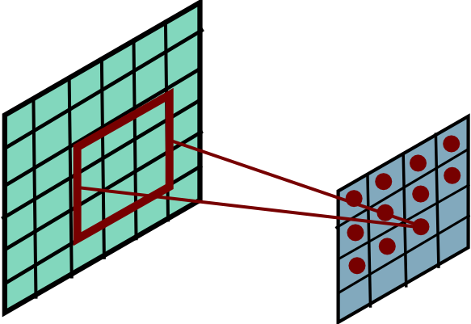
Convolutional Layer
Slide Credit: Marc'Aurelio Ranzato

Slide 42
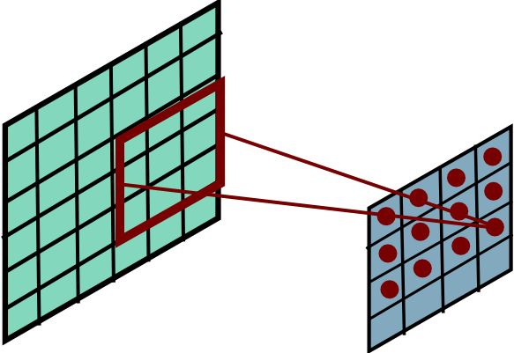
Convolutional Layer
Slide Credit: Marc'Aurelio Ranzato

Slide 43
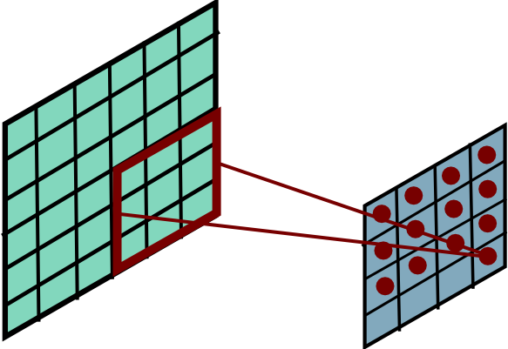
Convolutional Layer
Slide Credit: Marc'Aurelio Ranzato

Slide 44
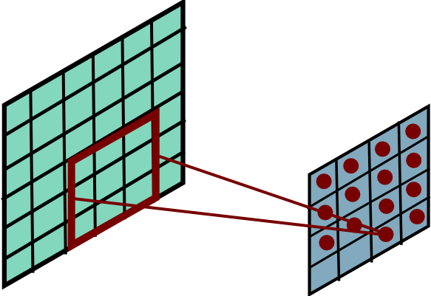
Convolutional Layer
Slide Credit: Marc'Aurelio Ranzato

Slide 45
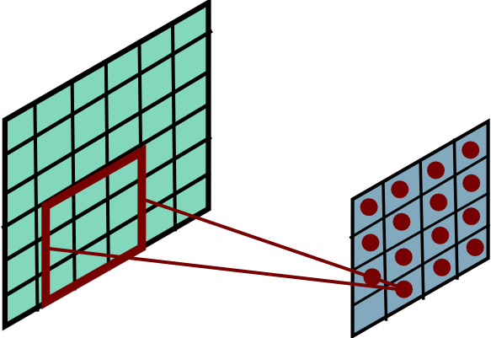
Convolutional Layer
Slide Credit: Marc'Aurelio Ranzato

Slide 46
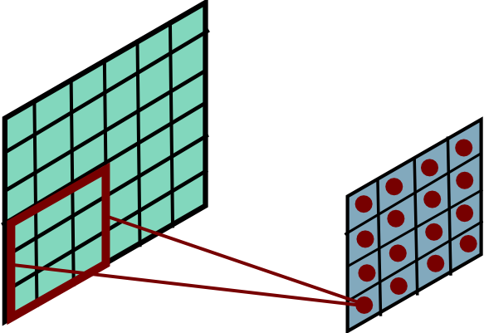
Convolutional Layer
Mathieu et al. “Fast training of CNNs through FFTs” ICLR 2014
Slide Credit: Marc'Aurelio Ranzato

Slide 47
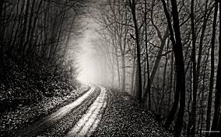
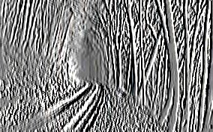
Convolutional Layer
-1 0 1
-1 0 1
-1 0 1
=
*
Slide Credit: Marc'Aurelio Ranzato

Slide 48
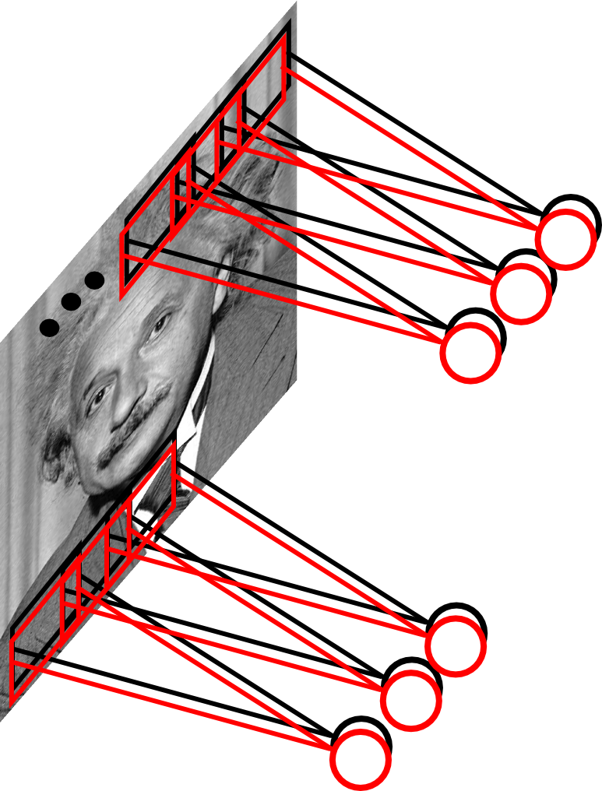
Convolutional Layer
Learn multiple filters.
E.g.: 200x200 image
100 Filters
Filter size: 10x10
10K parameters
Slide Credit: Marc'Aurelio Ranzato

Slide 49
Fully Connected Layer
32x32x3 image -> stretch to 3072 x 1
input
activation
1
1
3072
10 x 3072
weights
10
Slide Credit: Fei-Fei Li, Justin Johnson, Serena Yeung, CS 231n
Notes:
Preserve spatial structure of input

Slide 50
Fully Connected Layer
32x32x3 image -> stretch to 3072 x 1
input
activation
1
1
3072
10 x 3072
weights
10
1 number:
the result of taking a dot product between a row of W and the input (a 3072-dimensional dot product)
Slide Credit: Fei-Fei Li, Justin Johnson, Serena Yeung, CS 231n
Notes:
Preserve spatial structure of input

Slide 51
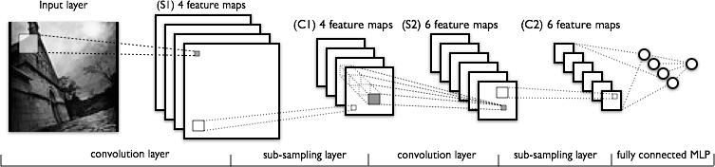
Convolutional Neural Networks
a
Image Credit: Yann LeCun, Kevin Murphy

Slide 52
FC vs Conv Layer

Slide 53
FC vs Conv Layer

Slide 54
FC vs Conv Layer

Slide 55
Convolution Layer
32x32x3 image -> preserve spatial structure
32
height
32
width
3
depth
Slide Credit: Fei-Fei Li, Justin Johnson, Serena Yeung, CS 231n
Notes:
Preserve spatial structure of input

Slide 56
Convolution Layer
32x32x3 image
5x5x3 filter
32
Convolve the filter with the image
i.e. “slide over the image spatially, computing dot products”
32
3
Slide Credit: Fei-Fei Li, Justin Johnson, Serena Yeung, CS 231n

Slide 57
Convolution Layer
Filters always extend the full depth of the input volume
32x32x3 image
5x5x3 filter
32
Convolve the filter with the image
i.e. “slide over the image spatially, computing dot products”
32
3
Slide Credit: Fei-Fei Li, Justin Johnson, Serena Yeung, CS 231n

Slide 58

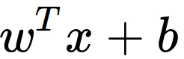
Convolution Layer
32x32x3 image
5x5x3 filter
32
1 number:
the result of taking a dot product between the filter and a small 5x5x3 chunk of the image
(i.e. 5*5*3 = 75-dimensional dot product + bias)
32
3
Slide Credit: Fei-Fei Li, Justin Johnson, Serena Yeung, CS 231n

Slide 59
Convolution Layer
activation map
32x32x3 image
5x5x3 filter
32
28
convolve (slide) over all spatial locations
32
28
3
1
Slide Credit: Fei-Fei Li, Justin Johnson, Serena Yeung, CS 231n

Slide 60
consider a second, green filter
Convolution Layer
32x32x3 image
5x5x3 filter
activation maps
32
28
convolve (slide) over all spatial locations
32
28
3
1
Slide Credit: Fei-Fei Li, Justin Johnson, Serena Yeung, CS 231n

Slide 61
For example, if we had 6 5x5 filters, we’ll get 6 separate activation maps:
activation maps
32
28
Convolution Layer
32
28
3
6
We stack these up to get a “new image” of size 28x28x6!
Slide Credit: Fei-Fei Li, Justin Johnson, Serena Yeung, CS 231n

Slide 62
Preview: ConvNet is a sequence of Convolution Layers, interspersed with activation functions
32
28
CONV,
ReLU
e.g. 6 5x5x3 filters
32
28
3
6
Slide Credit: Fei-Fei Li, Justin Johnson, Serena Yeung, CS 231n

Slide 63
Preview: ConvNet is a sequence of Convolutional Layers, interspersed with activation functions
32
28
24
….
CONV,
ReLU
e.g. 6 5x5x3 filters
CONV,
ReLU
e.g. 10 5x5x6 filters
CONV,
ReLU
32
28
24
3
6
10
Slide Credit: Fei-Fei Li, Justin Johnson, Serena Yeung, CS 231n

Slide 64
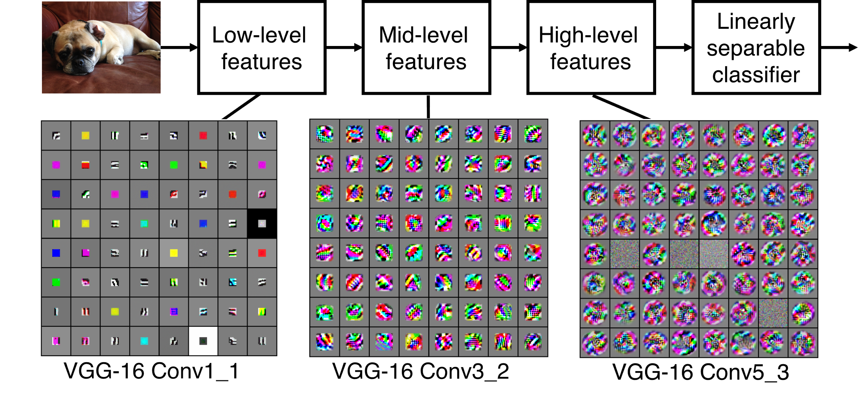
Preview
[Zeiler and Fergus 2013]
Visualization of VGG-16 by Lane McIntosh. VGG-16 architecture from [Simonyan and Zisserman 2014].
Slide Credit: Fei-Fei Li, Justin Johnson, Serena Yeung, CS 231n
Notes:
Each layer has many filters each producing an activation map
what ends up learning is hierarchy of filters, talk more in depth later
In this visualization [Lane] maximized the activity of a central cluster of units from the same filter type in various VGG-16 layers by taking image gradients. So not exactly what Zeiler and Fergus did, but somewhat similar.

Slide 65
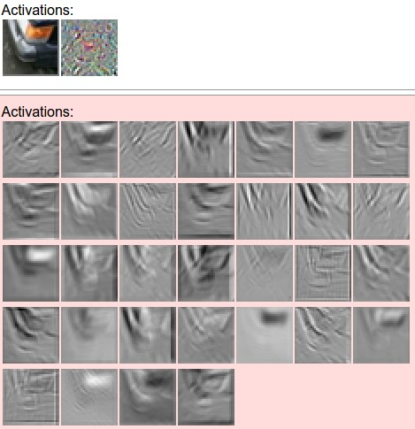
one filter =>
one activation map
example 5x5 filters
(32 total)
Figure copyright Andrej Karpathy.
Slide Credit: Fei-Fei Li, Justin Johnson, Serena Yeung, CS 231n
Notes:
Here have examples of activation maps produced by each filter
Each filter is slid over input to layer to produce an activation map
Because of sliding, call convolutional
Conv with neg. of filter (cross correlation)

Slide 66
Convolutional Neural Networks
a
Image Credit: Yann LeCun, Kevin Murphy

Slide 67

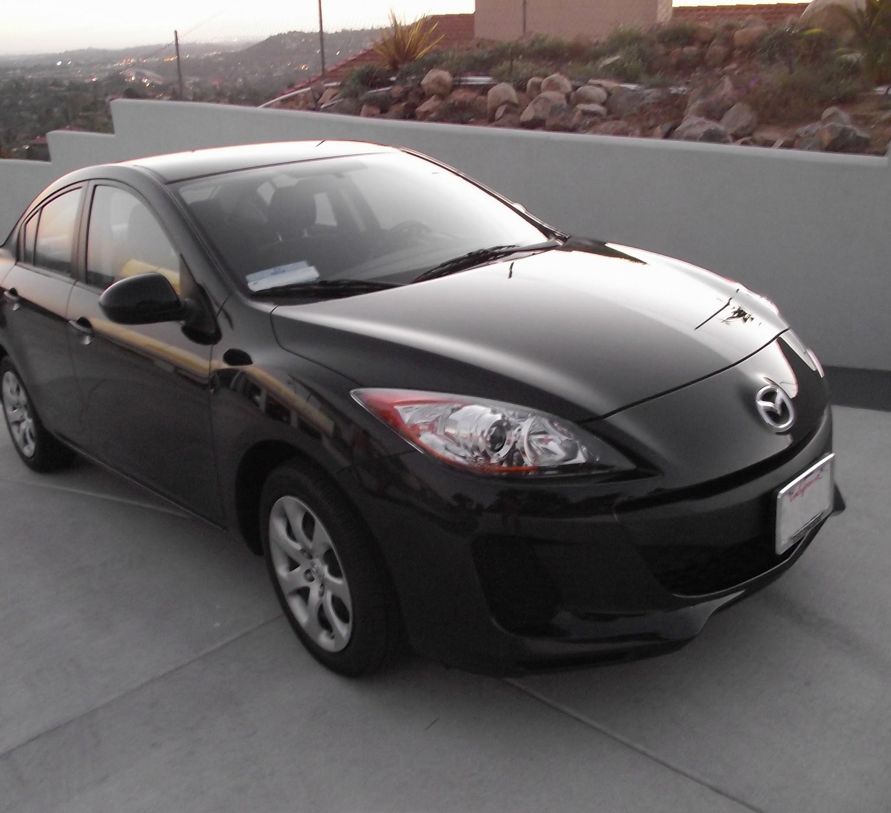
preview:
Slide Credit: Fei-Fei Li, Justin Johnson, Serena Yeung, CS 231n
Notes:
Convnet is stack of layers
Look at how an image progresses through the network, and sizes of output after each layer
Car image is photo taken by Lane McIntosh, permission to use.

Slide 68
A closer look at spatial dimensions:
activation map
32x32x3 image
5x5x3 filter
32
28
convolve (slide) over all spatial locations
32
28
3
1
Slide Credit: Fei-Fei Li, Justin Johnson, Serena Yeung, CS 231n

Slide 69
A closer look at spatial dimensions:
7
7x7 input (spatially)
assume 3x3 filter
7
Slide Credit: Fei-Fei Li, Justin Johnson, Serena Yeung, CS 231n

Slide 70
A closer look at spatial dimensions:
7
7x7 input (spatially)
assume 3x3 filter
7
Slide Credit: Fei-Fei Li, Justin Johnson, Serena Yeung, CS 231n

Slide 71
A closer look at spatial dimensions:
7
7x7 input (spatially)
assume 3x3 filter
7
Slide Credit: Fei-Fei Li, Justin Johnson, Serena Yeung, CS 231n

Slide 72
A closer look at spatial dimensions:
7
7x7 input (spatially)
assume 3x3 filter
7
Slide Credit: Fei-Fei Li, Justin Johnson, Serena Yeung, CS 231n

Slide 73
A closer look at spatial dimensions:
7
7x7 input (spatially)
assume 3x3 filter
=> 5x5 output
7
Slide Credit: Fei-Fei Li, Justin Johnson, Serena Yeung, CS 231n

Slide 74
A closer look at spatial dimensions:
7
7x7 input (spatially)
assume 3x3 filter
applied with stride 2
7
Slide Credit: Fei-Fei Li, Justin Johnson, Serena Yeung, CS 231n

Slide 75
A closer look at spatial dimensions:
7
7x7 input (spatially)
assume 3x3 filter
applied with stride 2
7
Slide Credit: Fei-Fei Li, Justin Johnson, Serena Yeung, CS 231n

Slide 76
A closer look at spatial dimensions:
7
7x7 input (spatially)
assume 3x3 filter
applied with stride 2
=> 3x3 output!
7
Slide Credit: Fei-Fei Li, Justin Johnson, Serena Yeung, CS 231n

Slide 77
A closer look at spatial dimensions:
7
7x7 input (spatially)
assume 3x3 filter
applied with stride 3?
7
Slide Credit: Fei-Fei Li, Justin Johnson, Serena Yeung, CS 231n

Slide 78
A closer look at spatial dimensions:
7
7x7 input (spatially)
assume 3x3 filter
applied with stride 3?
7
doesn’t fit!
cannot apply 3x3 filter on 7x7 input with stride 3.
Slide Credit: Fei-Fei Li, Justin Johnson, Serena Yeung, CS 231n

Slide 79
N
Output size:
(N - F) / stride + 1
e.g. N = 7, F = 3:
stride 1 => (7 - 3)/1 + 1 = 5
stride 2 => (7 - 3)/2 + 1 = 3
stride 3 => (7 - 3)/3 + 1 = 2.33 :\
F
F
N
Slide Credit: Fei-Fei Li, Justin Johnson, Serena Yeung, CS 231n

Slide 80
In practice: Common to zero pad the border
0 | 0 | 0 | 0 | 0 | 0
0
0
0
0
e.g. input 7x7
3x3 filter, applied with stride 1
pad with 1 pixel border => what is the output?
(recall:)
(N - F) / stride + 1
Slide Credit: Fei-Fei Li, Justin Johnson, Serena Yeung, CS 231n

Slide 81
In practice: Common to zero pad the border
0 | 0 | 0 | 0 | 0 | 0
0
0
0
0
e.g. input 7x7
3x3 filter, applied with stride 1
pad with 1 pixel border => what is the output?
7x7 output!
Slide Credit: Fei-Fei Li, Justin Johnson, Serena Yeung, CS 231n

Slide 82
In practice: Common to zero pad the border
0 | 0 | 0 | 0 | 0 | 0
0
0
0
0
e.g. input 7x7
3x3 filter, applied with stride 1
pad with 1 pixel border => what is the output?
7x7 output!
in general, common to see CONV layers with stride 1, filters of size FxF, and zero-padding with (F-1)/2. (will preserve size spatially)
e.g. F = 3 => zero pad with 1
F = 5 => zero pad with 2
F = 7 => zero pad with 3
Slide Credit: Fei-Fei Li, Justin Johnson, Serena Yeung, CS 231n

Slide 83
Remember back to…
E.g. 32x32 input convolved repeatedly with 5x5 filters shrinks volumes spatially!
(32 -> 28 -> 24 ...). Shrinking too fast is not good, doesn’t work well.
32
28
24
….
CONV,
ReLU
e.g. 6 5x5x3 filters
CONV,
ReLU
e.g. 10 5x5x6 filters
CONV,
ReLU
32
28
24
3
6
10
Slide Credit: Fei-Fei Li, Justin Johnson, Serena Yeung, CS 231n

Slide 84
Examples time:
Input volume: 32x32x3
10 5x5 filters with stride 1, pad 2
Output volume size: ?
Slide Credit: Fei-Fei Li, Justin Johnson, Serena Yeung, CS 231n
Notes:
(32+2*2-5)/1+1 = 32 spatially
(Input size + 2*padding - stride) / 1 + 1 for new spatial size
10 filters

Slide 85
Examples time:
Input volume: 32x32x3
10 5x5 filters with stride 1, pad 2
Output volume size:
(32+2*2-5)/1+1 = 32 spatially, so
32x32x10
Slide Credit: Fei-Fei Li, Justin Johnson, Serena Yeung, CS 231n

Slide 86
Examples time:
Input volume: 32x32x3
10 5x5 filters with stride 1, pad 2
Number of parameters in this layer?
Slide Credit: Fei-Fei Li, Justin Johnson, Serena Yeung, CS 231n
Notes:
each filter has 5*5*3 + 1 = 76 params
1 for bias

Slide 87
Examples time:
Input volume: 32x32x3
10 5x5 filters with stride 1, pad 2
Number of parameters in this layer?
each filter has 5*5*3 + 1 = 76 params (+1 for bias)
=> 76*10 = 760
Slide Credit: Fei-Fei Li, Justin Johnson, Serena Yeung, CS 231n

Slide 88
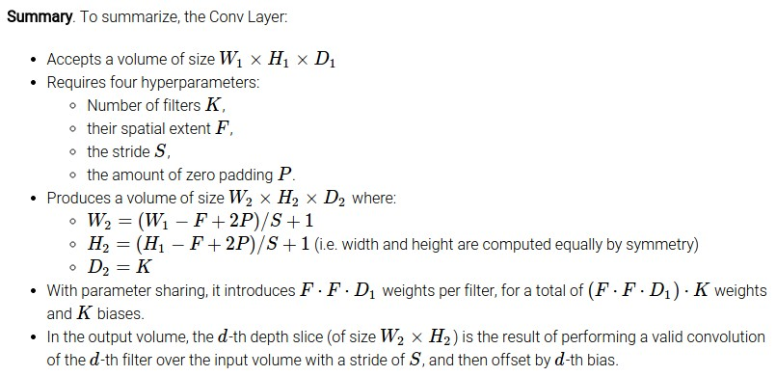
Slide Credit: Fei-Fei Li, Justin Johnson, Serena Yeung, CS 231n

Slide 89
Common settings:
K = (powers of 2, e.g. 32, 64, 128, 512)
F = 3, S = 1, P = 1
F = 5, S = 1, P = 2
F = 5, S = 2, P = ? (whatever fits)
F = 1, S = 1, P = 0
Slide Credit: Fei-Fei Li, Justin Johnson, Serena Yeung, CS 231n

Slide 90
(btw, 1x1 convolution layers make perfect sense)
1x1 CONV
with 32 filters
56
56
(each filter has size 1x1x64, and performs a 64-dimensional dot product)
56
56
64
32
Slide Credit: Fei-Fei Li, Justin Johnson, Serena Yeung, CS 231n

Slide 91
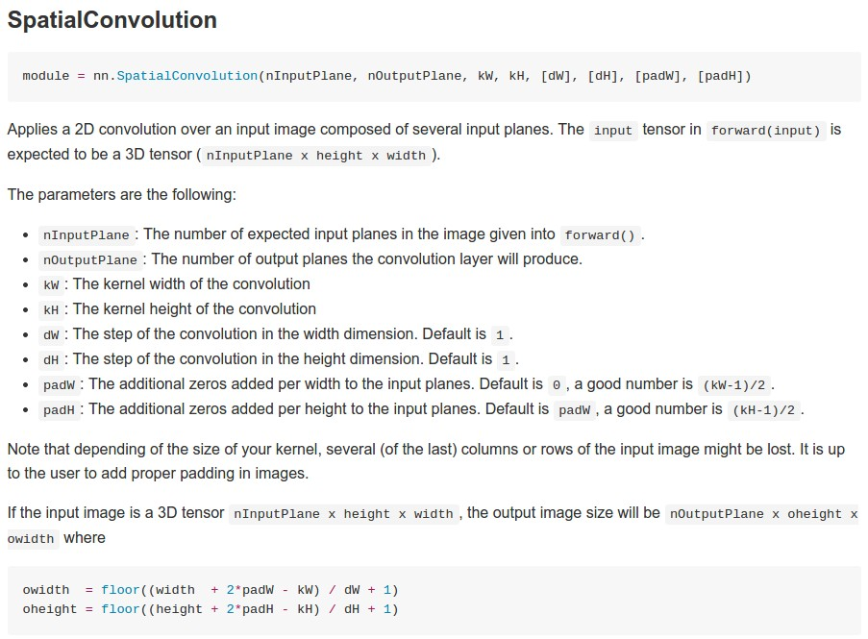
Example: CONV layer in Torch
Torch is licensed under BSD 3-clause.
Slide Credit: Fei-Fei Li, Justin Johnson, Serena Yeung, CS 231n

Slide 92
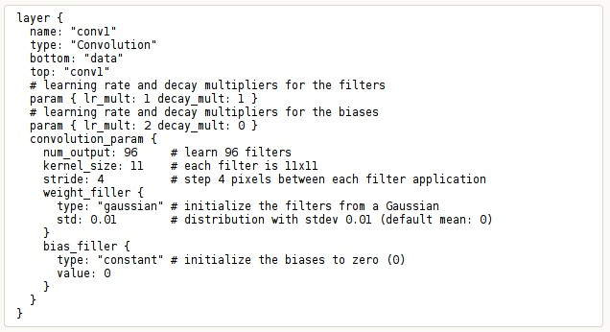
Example: CONV layer in Caffe
Caffe is licensed under BSD 2-Clause.
Slide Credit: Fei-Fei Li, Justin Johnson, Serena Yeung, CS 231n

Slide 93

The brain/neuron view of CONV Layer
32
28
An activation map is a 28x28 sheet of neuron outputs:
Each is connected to a small region in the input
All of them share parameters
“5x5 filter” -> “5x5 receptive field for each neuron”
32
28
3
Slide Credit: Fei-Fei Li, Justin Johnson, Serena Yeung, CS 231n

Slide 94
Reminder: Fully Connected Layer
Each neuron looks at the full input volume
32x32x3 image -> stretch to 3072 x 1
input
activation
1
1
3072
10 x 3072
weights
10
1 number:
the result of taking a dot product between a row of W and the input (a 3072-dimensional dot product)
Slide Credit: Fei-Fei Li, Justin Johnson, Serena Yeung, CS 231n
Notes:
Preserve spatial structure of input

Slide 95
two more layers to go: POOL/FC
Slide Credit: Fei-Fei Li, Justin Johnson, Serena Yeung, CS 231n
Notes:
Car image is photo taken by Lane McIntosh, permission to use.

Slide 96
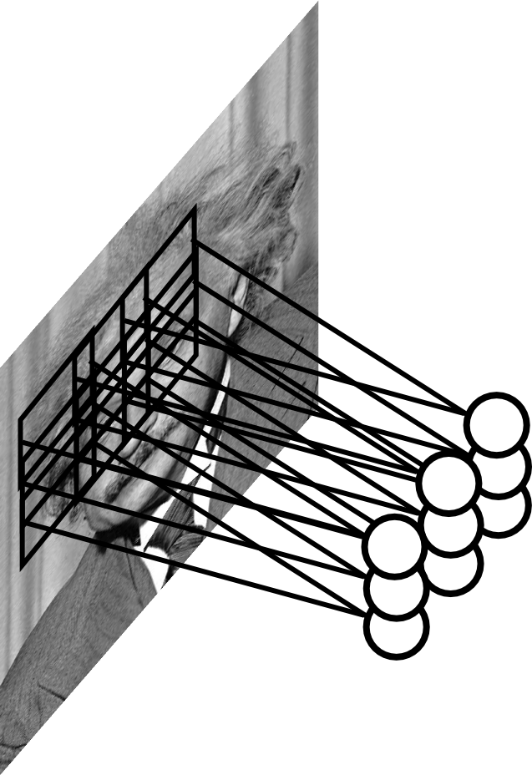
Pooling Layer
Let us assume filter is an “eye” detector.
Q.: how can we make the detection robust to the exact location of the eye?
Slide Credit: Marc'Aurelio Ranzato

Slide 97
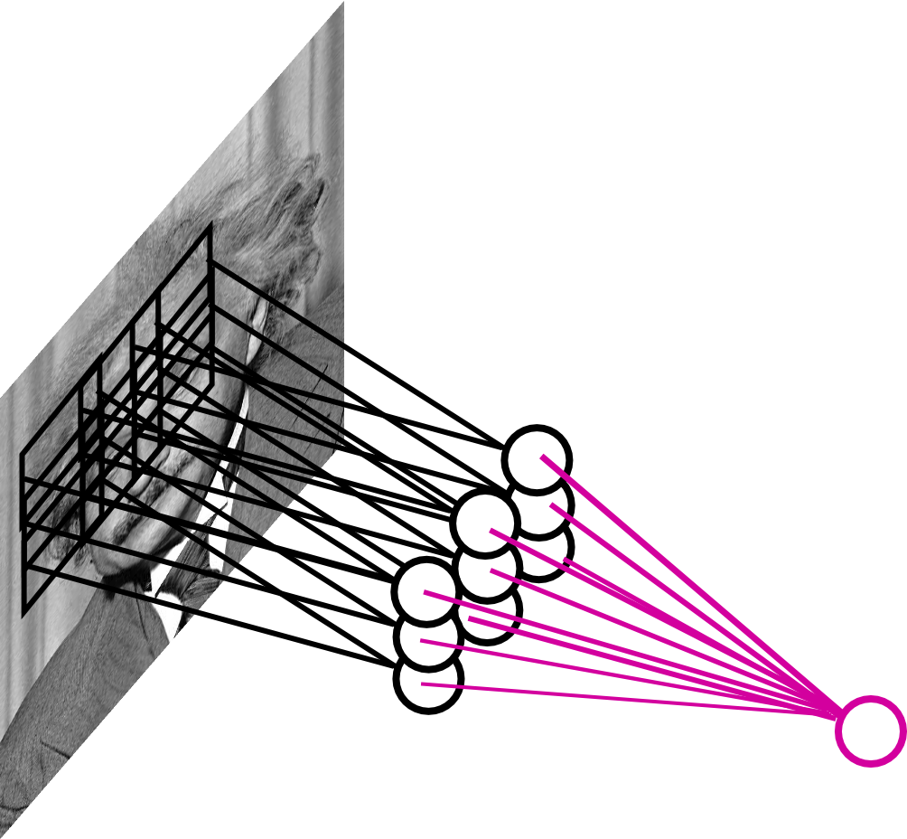
Pooling Layer
By “pooling” (e.g., taking max) filter
responses at different locations we gain robustness to the exact spatial location of features.
Slide Credit: Marc'Aurelio Ranzato

Slide 98

Pooling layer
makes the representations smaller and more manageable
operates over each activation map independently:
Slide Credit: Fei-Fei Li, Justin Johnson, Serena Yeung, CS 231n

Slide 99
MAX POOLING
Single depth slice
1 | 1 | 2 | 4
5 | 6 | 7 | 8
3 | 2 | 1 | 0
1 | 2 | 3 | 4
dim 1
max pool with 2x2 filters and stride 2
6 | 8
3 | 4
dim 2
Slide Credit: Fei-Fei Li, Justin Johnson, Serena Yeung, CS 231n

Slide 100
Pooling Layer: Examples
Max-pooling:
Average-pooling:
L2-pooling:
L2-pooling over features:
Slide Credit: Marc'Aurelio Ranzato

Slide 101
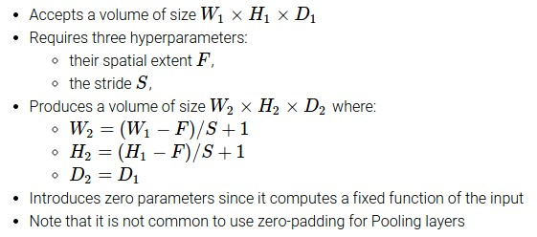
Slide Credit: Fei-Fei Li, Justin Johnson, Serena Yeung, CS 231n

Slide 102
Common settings:
F = 2, S = 2
F = 3, S = 2
Slide Credit: Fei-Fei Li, Justin Johnson, Serena Yeung, CS 231n

Slide 103
Pooling Layer: Receptive Field Size
Conv.
layer
Pool.
layer
If convolutional filters have size KxK and stride 1, and pooling layer has pools of size PxP, then each unit in the pooling layer depends upon a patch (at the input of the preceding conv. layer) of size: (P+K-1)x(P+K-1)
Slide Credit: Marc'Aurelio Ranzato

Slide 104
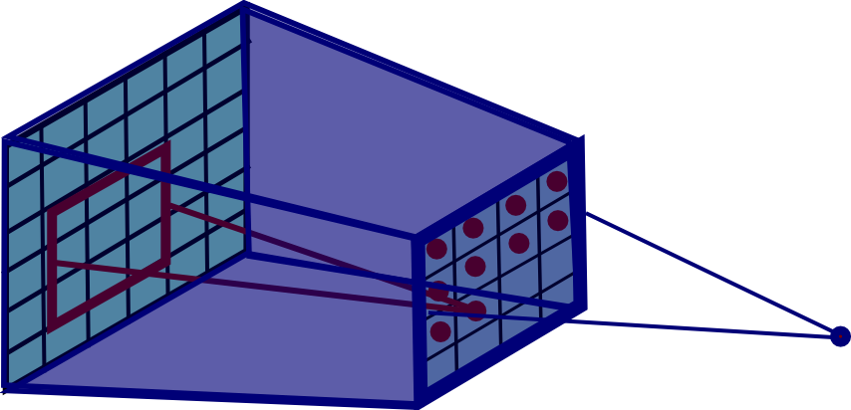
Pooling Layer: Receptive Field Size
Conv.
layer
Pool.
layer
If convolutional filters have size KxK and stride 1, and pooling layer has pools of size PxP, then each unit in the pooling layer depends upon a patch (at the input of the preceding conv. layer) of size: (P+K-1)x(P+K-1)
Slide Credit: Marc'Aurelio Ranzato

Slide 105
Fully Connected Layer (FC layer)
Contains neurons that connect to the entire input volume, as in ordinary Neural Networks
Slide Credit: Fei-Fei Li, Justin Johnson, Serena Yeung, CS 231n
Notes:
Car image is photo taken by Lane McIntosh, permission to use.

Slide 106
Convolutional Nets
Example:
http://yann.lecun.com/exdb/lenet/index.html
Image Credit: Yann LeCun, Kevin Murphy

Slide 107
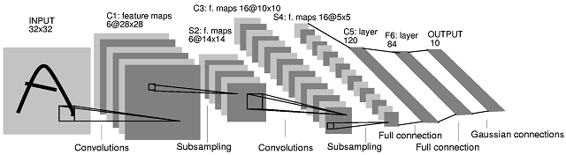
Note: After several stages of convolution-pooling, the spatial resolution is greatly reduced (usually to about 5x5) and the number of feature maps is large (several hundreds depending on the application).
It would not make sense to convolve again (there is no translation invariance and support is too small). Everything is vectorized and fed into several fully connected layers.
If the input of the fully connected layers is of size 5x5xN, the first fully connected layer can be seen as a conv. layer with 5x5 kernels.
The next fully connected layer can be seen as a conv. layer with 1x1 kernels.
Slide Credit: Marc'Aurelio Ranzato

Slide 108
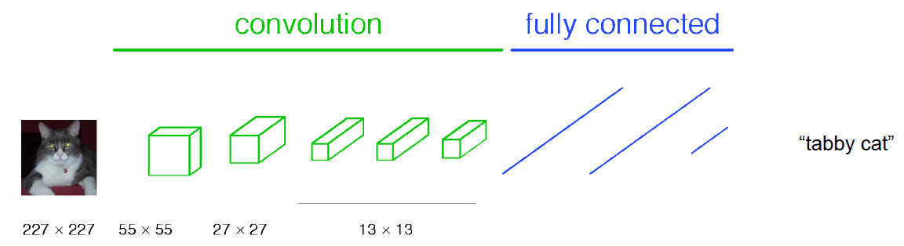
Classical View
Figure Credit: [Long, Shelhamer, Darrell CVPR15]

Slide 109
H hidden units
MxMxN, M small
Fully conn. layer
Slide Credit: Marc'Aurelio Ranzato

Slide 110
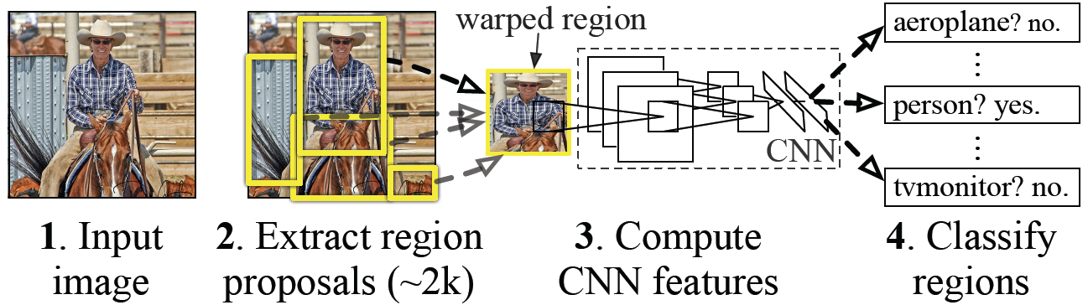
Classical View = Inefficient

Slide 111
Classical View
Figure Credit: [Long, Shelhamer, Darrell CVPR15]

Slide 112
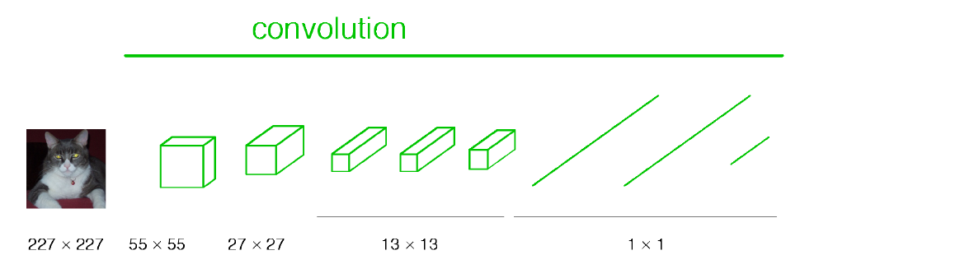
Re-interpretation
Just squint a little!
Figure Credit: [Long, Shelhamer, Darrell CVPR15]

Slide 113
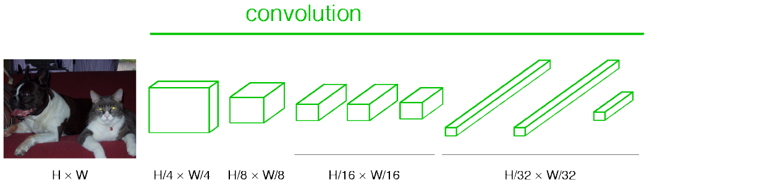
“Fully Convolutional” Networks
Can run on an image of any size!
Figure Credit: [Long, Shelhamer, Darrell CVPR15]

Slide 114
H hidden units /
1x1xH feature maps
MxMxN, M small
Fully conn. layer /
Conv. layer (H kernels of size MxMxN)
Slide Credit: Marc'Aurelio Ranzato

Slide 115
K hidden units /
1x1xK feature maps
H hidden units /
1x1xH feature maps
MxMxN, M small
Fully conn. layer /
Conv. layer (H kernels of size MxMxN)
Fully conn. layer /
Conv. layer (K kernels of size 1x1xH)
Slide Credit: Marc'Aurelio Ranzato

Slide 116
Viewing fully connected layers as convolutional layers enables efficient use of convnets on bigger images (no need to slide windows but unroll network over space as needed to re-use computation).
TRAINING TIME
Input
Image
CNN
TEST TIME
Input
Image
Input
Image
CNN
y
x
Slide Credit: Marc'Aurelio Ranzato

Slide 117
Viewing fully connected layers as convolutional layers enables efficient use of convnets on bigger images (no need to slide windows but unroll network over space as needed to re-use computation).
TRAINING TIME
Input
Image
CNN
TEST TIME
CNNs work on any image size!
Input
Image
CNN
y
x
Unrolling is order of magnitudes more eficient than sliding windows!
Slide Credit: Marc'Aurelio Ranzato

Slide 118
Re-interpretation
Just squint a little!
Figure Credit: [Long, Shelhamer, Darrell CVPR15]

Slide 119
“Fully Convolutional” Networks
Can run on an image of any size!
Figure Credit: [Long, Shelhamer, Darrell CVPR15]

Slide 120
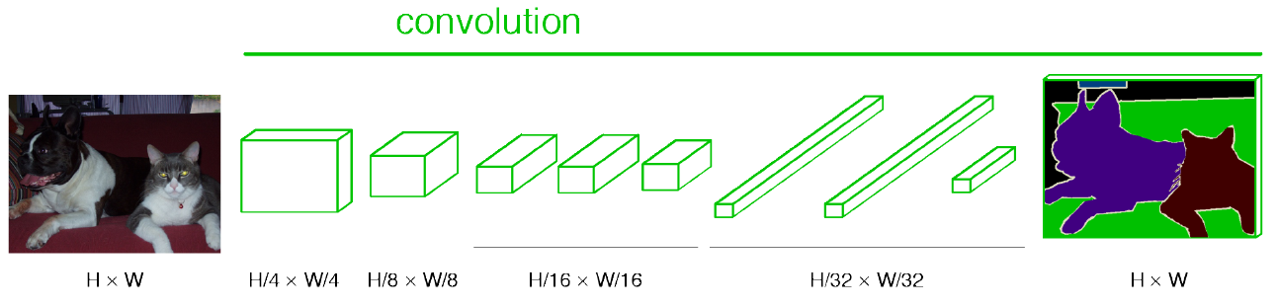
“Fully Convolutional” Networks
Up-sample to get segmentation maps
Figure Credit: [Long, Shelhamer, Darrell CVPR15]

Slide 121
Benefit of this thinking
Mathematically elegant
Efficiency
Can run network on arbitrary image
Without multiple crops

Slide 122
Summary
- ConvNets stack CONV,POOL,FC layers
- Trend towards smaller filters and deeper architectures
- Trend towards getting rid of POOL/FC layers (just CONV)
- Typical architectures look like
[(CONV-RELU)*N-POOL?]*M-(FC-RELU)*K,SOFTMAX
where N is usually up to ~5, M is large, 0 <= K <= 2.
but recent advances such as ResNet/GoogLeNet challenge this paradigm
Slide Credit: Fei-Fei Li, Justin Johnson, Serena Yeung, CS 231n

